Slide 1

Retail-Net

Slide 2
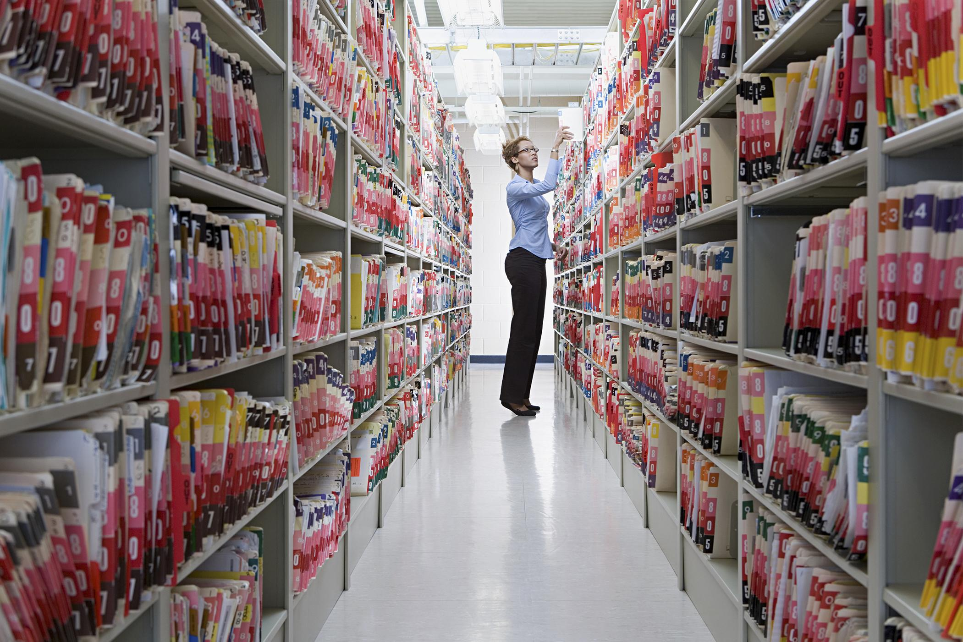
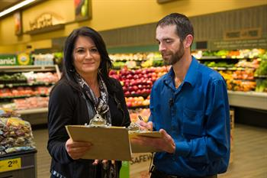
Problem statement
Most of the consumer good companies send field staff to visit each of the stores across cities/regions/country to audit the stores for promotional compliance, inventory check and also do get some competitive insights.
If the picture of the aisle is provided, then determine :
Product Arrangement
Product Sales Analysis
Product Stock forecast
Brand Coverage

Slide 3
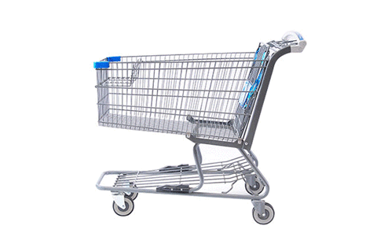
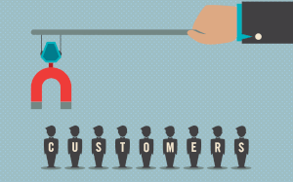
Solution Proposal
Increasing Sales
Increasing Customer

Slide 4


Database – Forecasting
Product Stocking
Using sales history, store manager can forecast product requirements, rather than going into out-of-stock order
Product Analysing
Understanding customers sentiments ensures more procuct sales and less chances of product not been sold-out

Slide 5
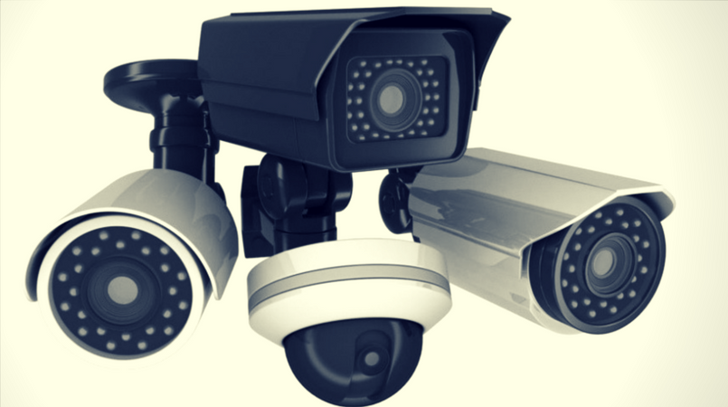
Camera – DeepLearning
Product brand coverage
Product Misplacement
On-Fly Out-Of-Stock
Promotional product placement
Floor coverage
most visited rack

Slide 6
Architecture Layout

Slide 7
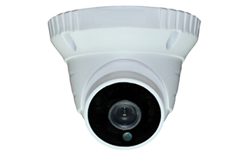


Object Detection:
Yolo
Object Classification:
Yolo
Upload Camera Feeds
Person Tracking:
Yolo
OpenCv
Numpy
TensorFlow 1.4.0
Sklean
Empty Rack:
OpenCv
Numpy
Identified Product
Store Staff
Store Database
Tableau worksheet
Forecast
WEB Application

Slide 8
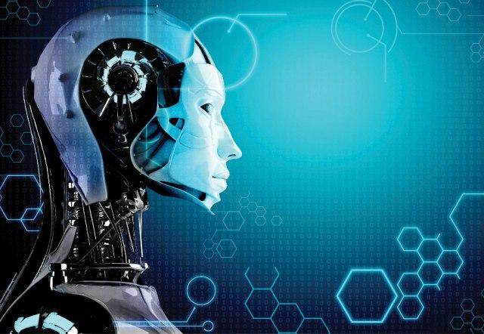
Pre-Processing
For Database:-
Since tableau is capable of loading data from multiple environment, thus it is easy to load the data. Convert the loaded data into denormalized format for analysing and predicting the trend
Cleansing of the data is required, as Transaction_id can never be null , such data should be removed before starting the forecast process
For the Camera Feed:-
For all the new type classes that are added, have maximum possible annotated images for new class.
For increasing the training dataset, augmente the images using OpenCv
Using the Darknet architecture frame for training the new retail dataset

Slide 9

Multiple camera located across the store, getting complete store view at one glance
All in-store product information
Store floor plan and product placement information
Historical sales information

Slide 10

Demo
BBy Team,
Greeks & Freaks

